Slide 1
Heart Disease
Classification
Project
Group 3

Slide 2


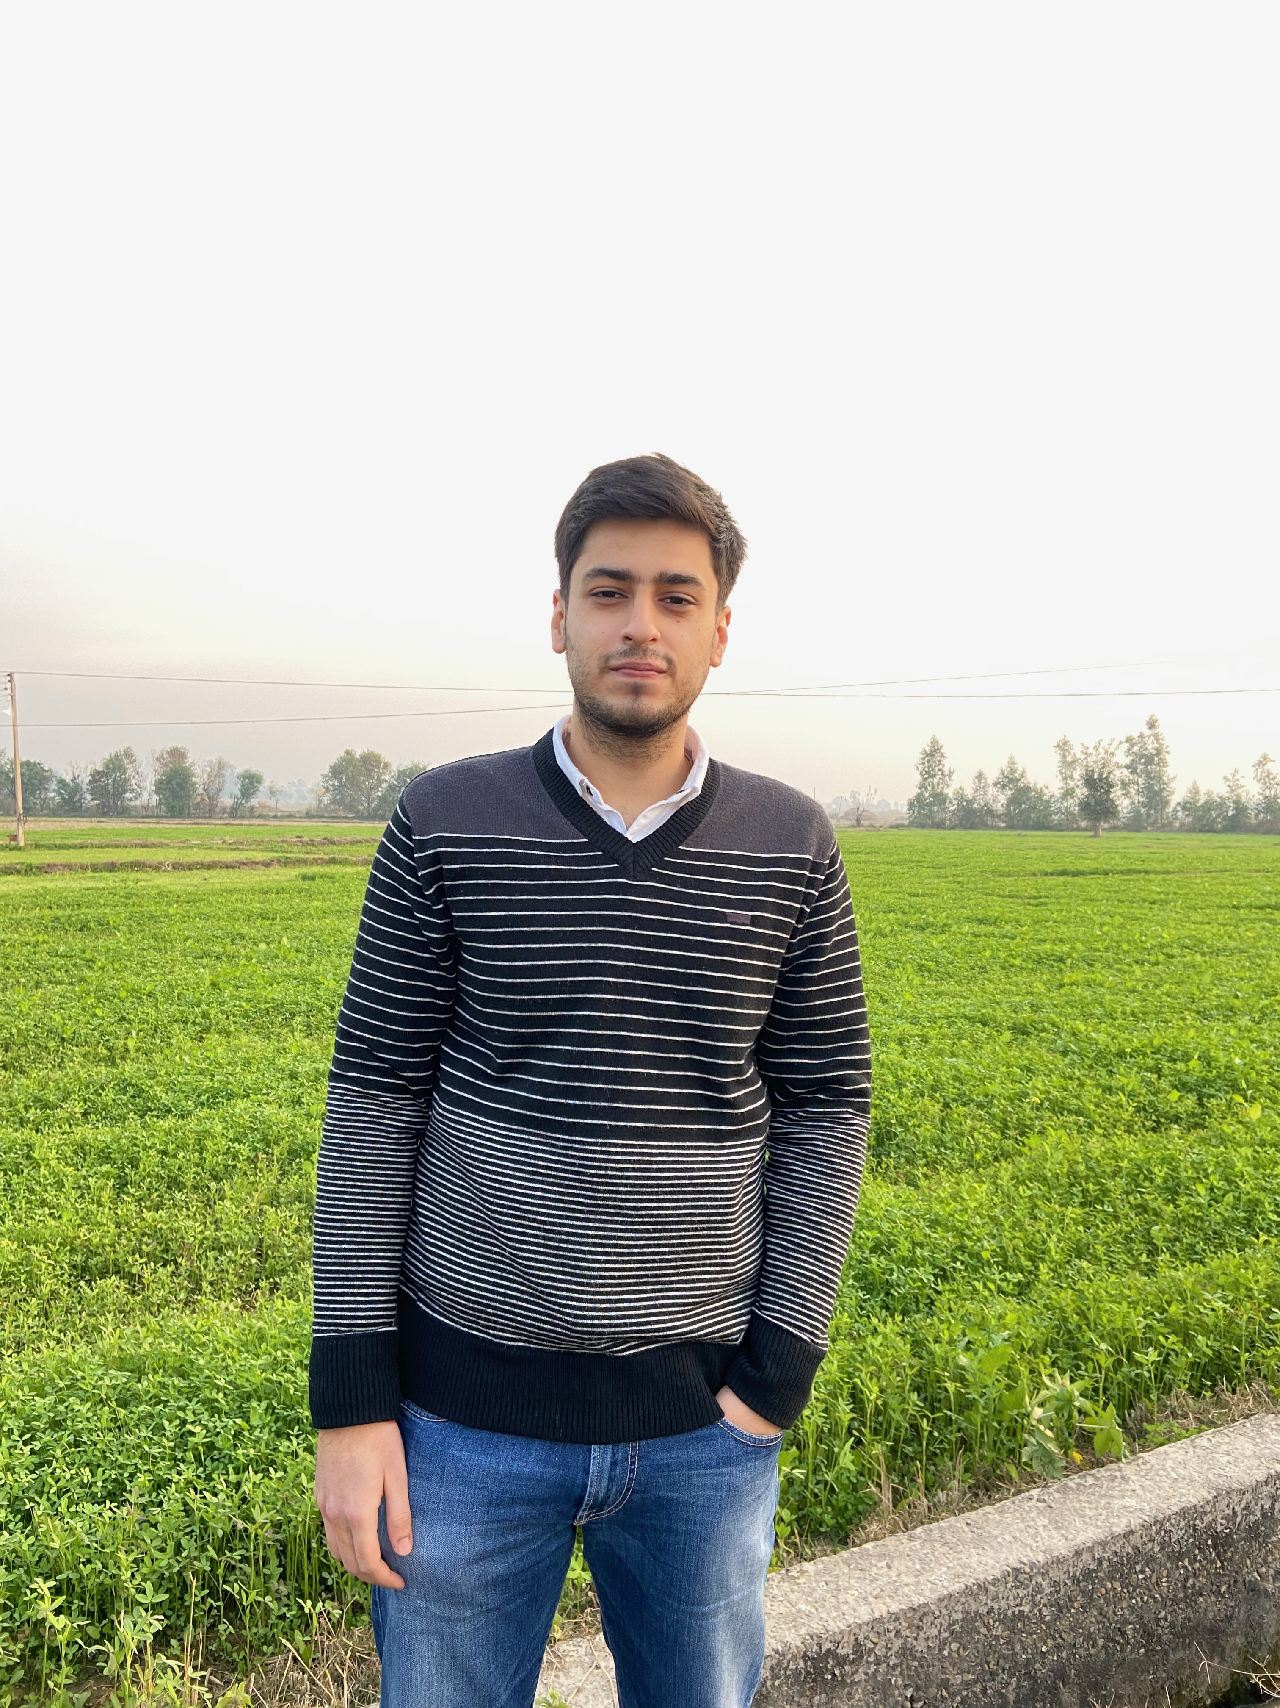

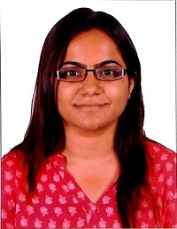

OUR TEAM
Karthick Vel
Kathirvel
Aakash Dhruva
Anubhav Nehru
Mayank Gupta
Deepti Hariyani
Zihao Zhu

Slide 3

CONTENTS
1
Introduction: problem statement & data snapshot
2
Our Approach​
3
Exploratory Data Analysis
4
Data Preprocessing
5
Modelling
6
Conclusion
Notes:
Previous contents: Problem Statement : Problem, Statement, Proposal
Walk through data set/ Data Snapshot
Our Approach
EDA
Modelling
Feature engineering
Comparing model findings with EDA Findings
Conclusion
Our Recommendation

Slide 4
1
INTRODUCTION
Problem statement and data snapshot

Slide 5
695,000
people in the United States died from heart disease in 2021
Notes:
About 695,000 people in the United States died from heart disease in 2021—that’s 1 in every 5 deaths

Slide 6
~26 days
Patient waiting time to specialists

Slide 7
Objective:
Business Use case: Reduce waiting time for patient to get a heart specialist appointment by building a screening tool for CVD
Approach: Use patient health and lifestyle metrics to identify if a patient is susceptible to getting cardiovascular disease
Potential Outcomes:
Enhance Preventive Care
Optimize Resource Allocation
Reduce heart disease related death
Notes:
Our objective is to create a model that will identify if a patient is susceptible to getting a cardiovascular disease. Local hospital or doctor office will be benefit with our classification because they can prioritize those with higher possibility of getting heart disease and increase their diagnosis efficiency.

Slide 8
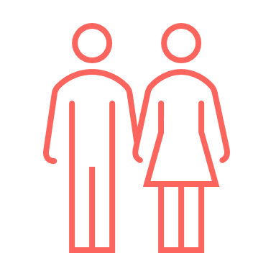

Data Snapshot
~309,000
*processed 2021 BRFSS Dataset from Kaggle
Notes:
Behavioral Risk Factor Surveillance System (BRFSS) is a branch of the Centers for Disease Control and Prevention (CDC)

Slide 9
Data Snapshot
Height
Weight
BMI
Fruit Consumption
NUMERIC
Alcohol Consumption
Fried Potato Consumption
Green/Vegetables Consumption
Sex
Age Category
Exercise
General Health
Checkup
Smoking History
Diabetes
Depression
CATEGORRCAL
Arthritis
Skin Cancer
Heart Disease
Other Cancer

Slide 10
2
OUR APPROACH

Slide 11
APPROACH
4.) Model :
Train the model using a train-test split.
Make predictions on the test set.
Evaluate the performance of the trained model using appropriate evaluation metrics.
1.) Data :
Investigate the influence of variables on target.
3.) Prep data before modelling :
Remove variables that don't add value to model
One hot encoding
Ordinal encoding
Remove outliers
Dropped duplicates
Converted some categorical variables to binary
2.) EDA :
Understand the distributions of variables.
Explore potential relationships between the variables and target.

Slide 12
3
EXPLORATORY DATA ANALYSIS
Let's explore our dataset to find interesting insights......

Slide 13
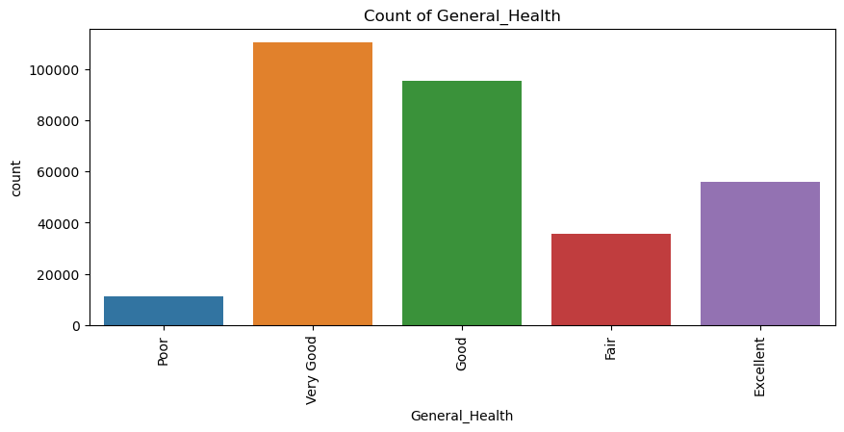
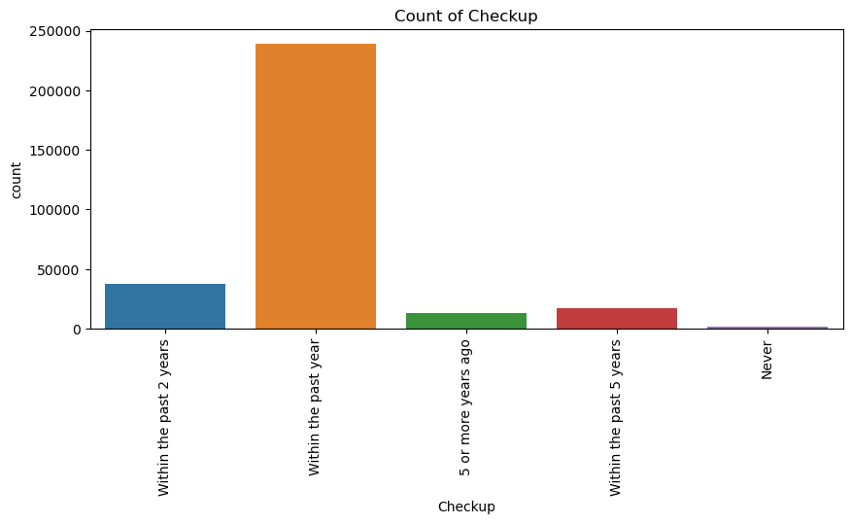
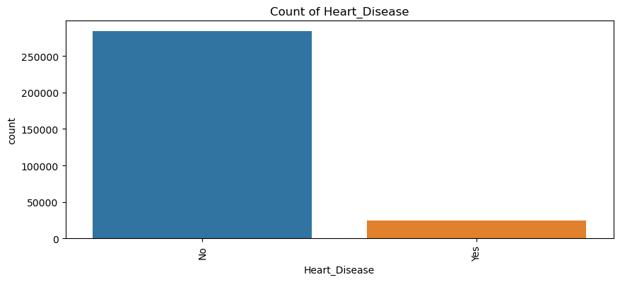
Univariate Analysis
Takeaway: Most patients rated their general health as "Good" or "Very Good" and had their last checkup within the past year. Additionally, our target variable is highly imbalanced towards negative class
Notes:
categorical variables displayed diverse distributions.
1.) most patients rated their general health as "Good" or "Very Good" and had their last checkup within the past year.
2.) and a majority did not have a history of smoking.

Slide 14
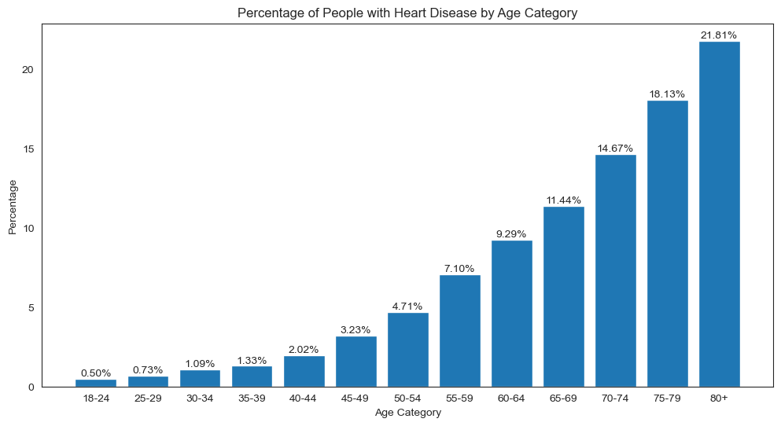
Do you become more prone to CVD's as you grow old?
Takeaway: People generally tend to have more risk of CVD as they grow older

Slide 15
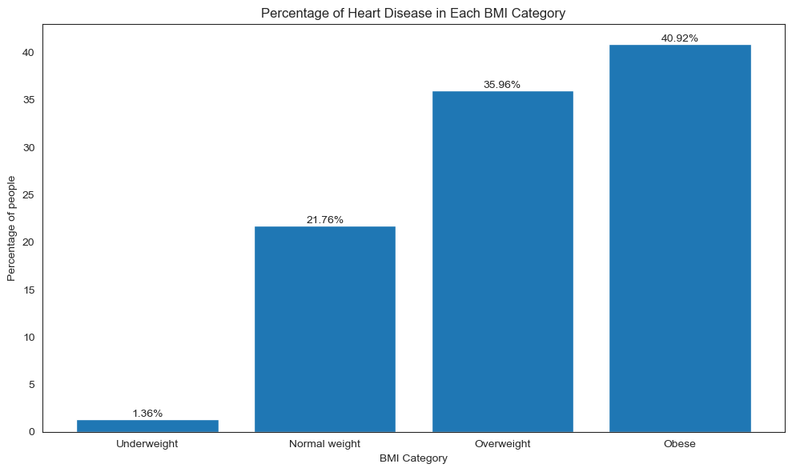
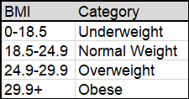
Does obesity increase the risk of CVD?
Takeaway: Overweight and obese people tend to have a higher risk of suffering from CVD

Slide 16
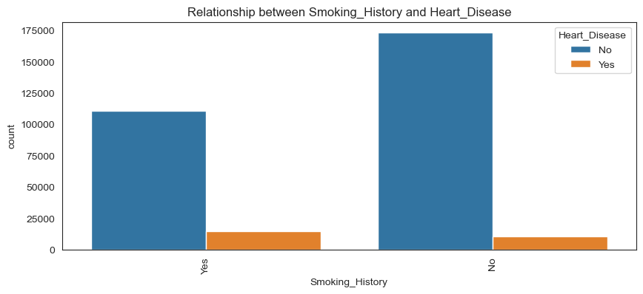
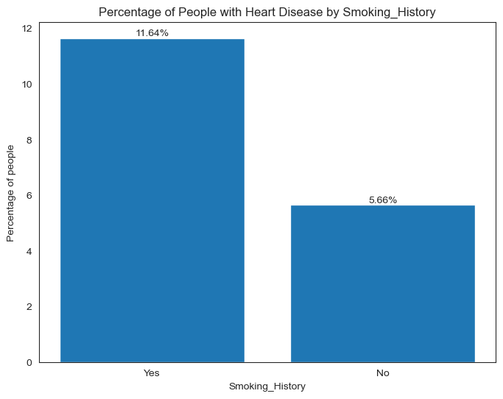
Does smoking lead to CVD's?
Takeaway: Smoking tends to elevate the risk of CVD

Slide 17
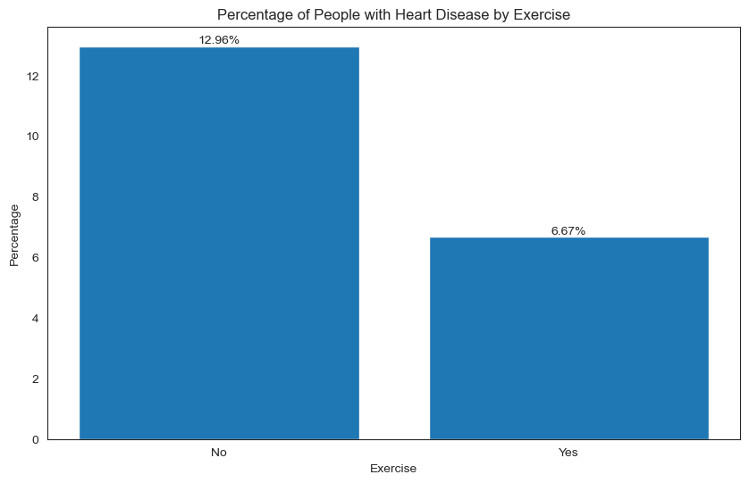
Does exercise play a role in reducing the risk of CVD?
Takeaway: There is a higher likelihood of getting a heart disease among people who don't exercise regularly

Slide 18
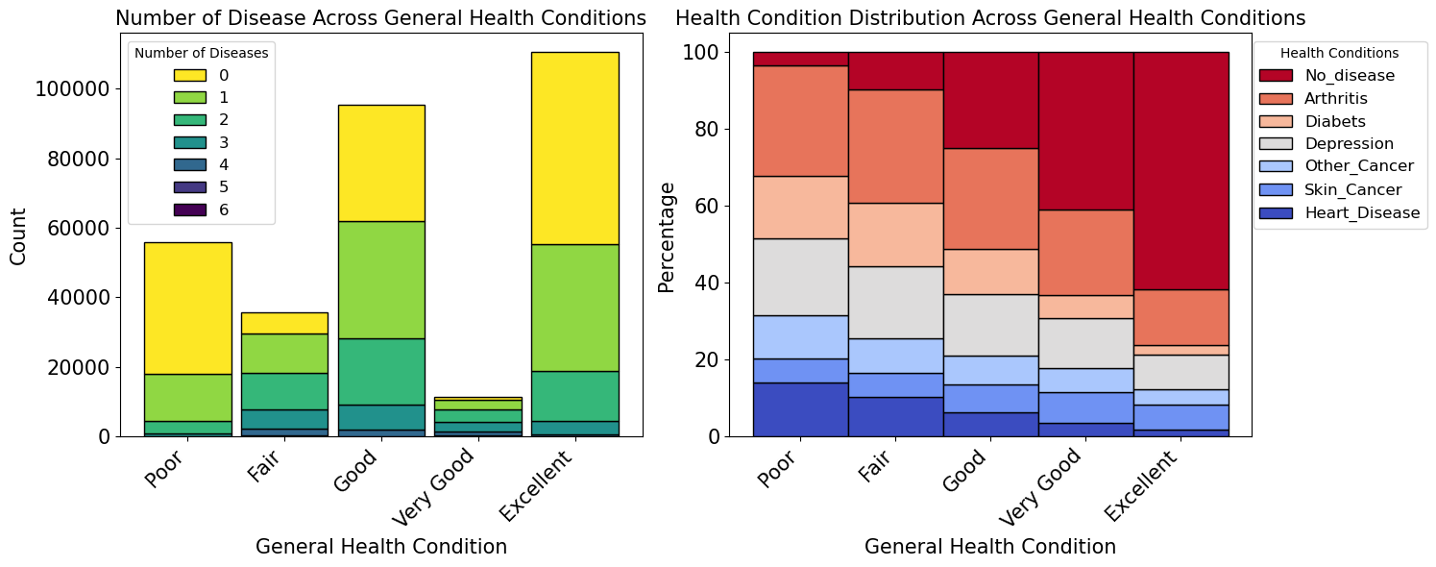
What does excellent health actually mean?
Takeaway: While overall general health feeling is a good indicator of no disease but even excellent health doesn't necessarily mean no disease

Slide 19
Are males more prone to heart disease?
Sex | Total Counts | %
Female | 160,196 | 51.9%
Male | 148,658 | 48.1%
 | Heart Disease
Sex | No | Yes
Female | 52.9% | 39.6%
Male | 47.1% | 60.4%
Null hypothesis: Females are equally likely to get cardiovascular disease as males. Chi squared score: 1612 P-value: 0.0
Result: Reject null hypothesis
Takeaway: Males are 50% more likely to get a cardiovascular disease compared with females.

Slide 20
Is the public notion about alcohol consumption leading to CVD true?
Drinking Frequency (# days) | % CVD
Non-Drinker (0) | 10.6%
Light Drinker (1-6) | 6.1%
Moderate Drinker (7-14) | 4.8%
Heavy Drinker (15- above) | 7.2%
These stats talk about frequency and not quantity!!
Null hypothesis: Alcohol consumption has no the risk of getting cardio-vascular disease. T test score: 3.22 P-value: 0.004
Result: Reject null hypothesis
Takeaway: Moderate drinkers tend to have lesser risk of CVD compared to others.

Slide 21
4
Data Preprocessing

Slide 22
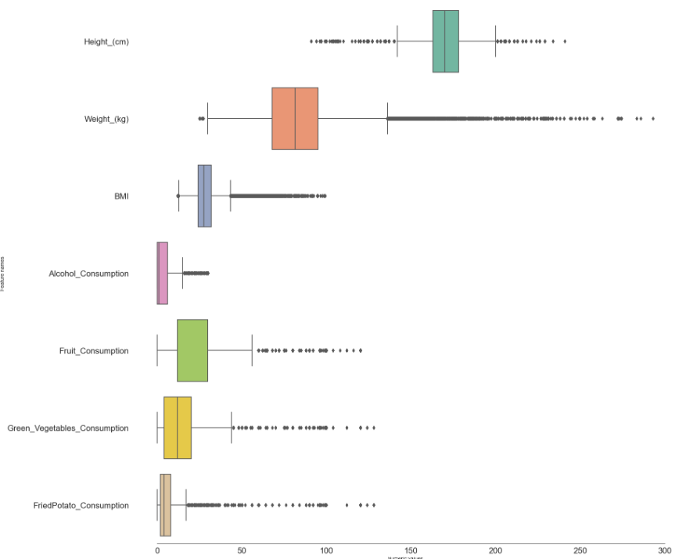
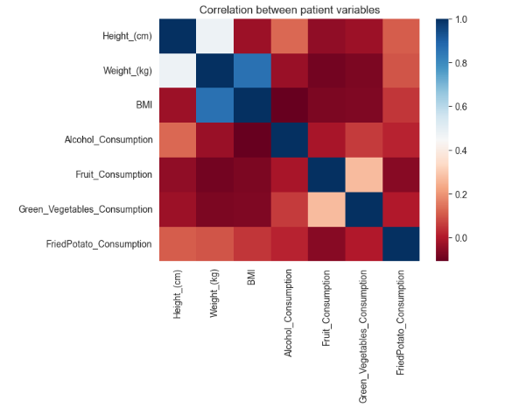
Outlier Analysis and correlation matrix

Slide 23
Intuitive Feature Engineering + Auto Encoding + Sampling
Outlier Treatment
Removed patients based on the Height to Weight ratio column
Feature Engineering + Autoencoder
Mutated Height to Weight Ratio
The ratios with Std. Dev. > 3.5 from mean were removed
Data Cleaning
There were around 20 duplicate values in our data and no null values
Combined Skin Cancer and other Cancer
SMOTE gave better accuracy than Near Miss on logistic regression
Model Training
Balancing the data
SMOTE and Near Miss Algorithm were used to balance the data
Trained the data on Logistic Regression, Random Forest Classifier and Gradient Boosting Classifier
Lifestyle score did not boost the model’s performance
Binned Age and BMI category
Combined **lifestyle features
Autoencoder tuning:
# Hidden layers
Activation functions
Number of output nodes
Learning rate: Adaptive
Batch size
Loss: “MSE”
Final Architecture: 7 x 5 x 2 x 5 x 7
**Lifestyle features: 'Checkup', 'Exercise', 'Smoking_History', 'Alcohol_Consumption',
'Fruit_Consumption', 'Green_Vegetables_Consumption', 'FriedPotato_Consumption'

Slide 24
5
MODELLING

Slide 25
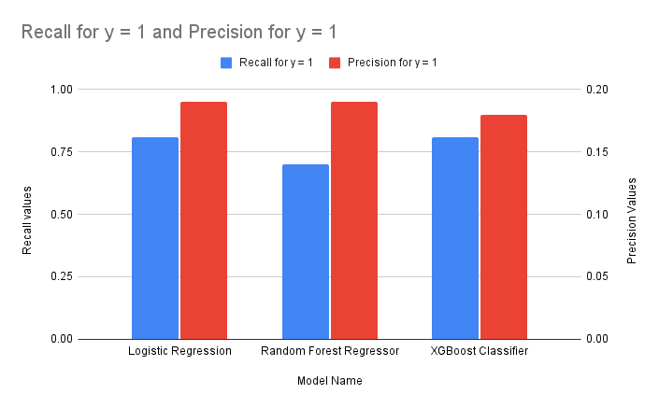
Model Performance Overview
Given that we have to classify if a patient has CVD or not, our focus is on a model which provides a high recall so that there are fewer false negative cases

Slide 26
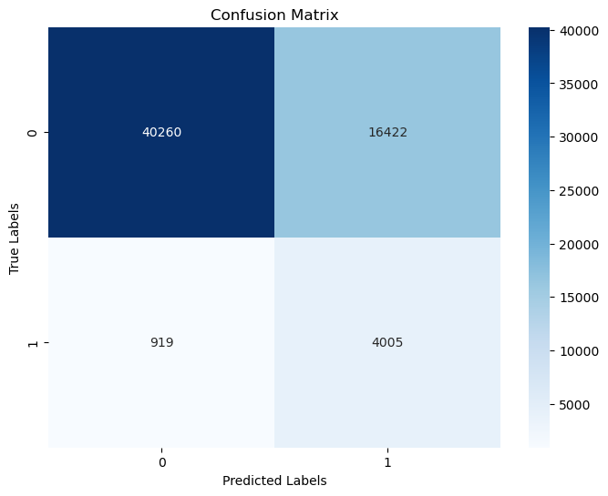
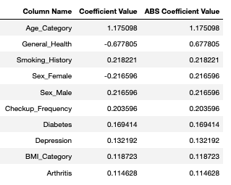
Logistic Regression
Accuracy | Precision | Recall | Parameters
0.71 | 0.19 | 0.81 | Optimal Threshold = 0.471

Slide 27
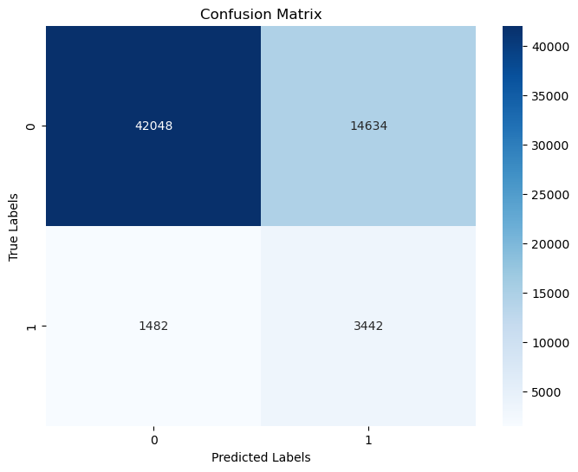
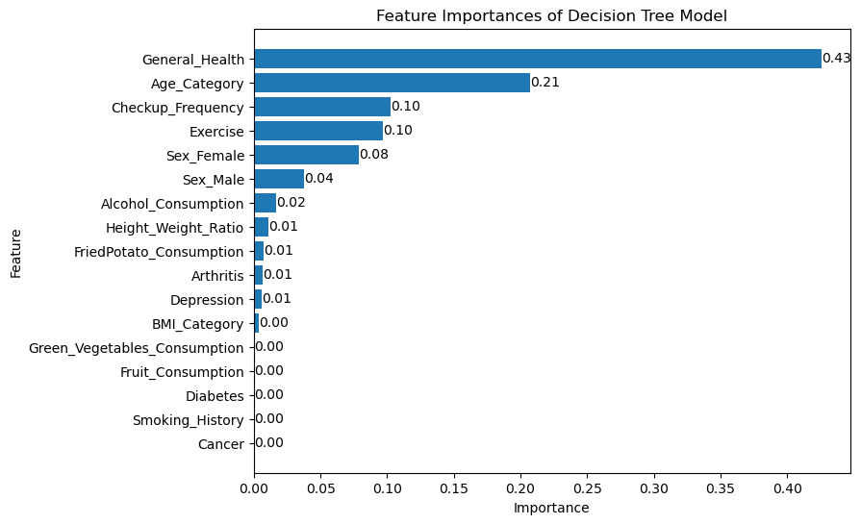
Random Forest Classifier
Accuracy | Precision | Recall
0.74 | 0.19 | 0.70

Slide 28
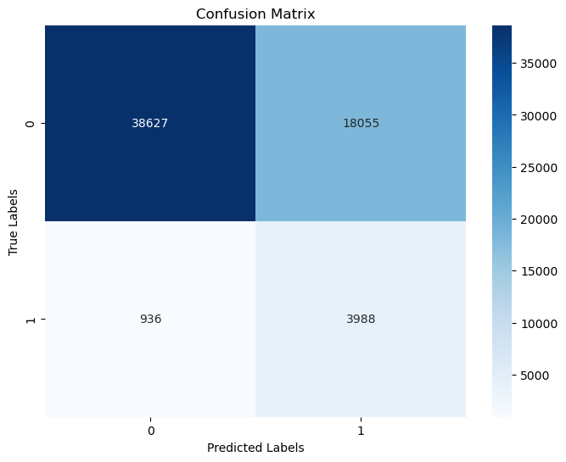
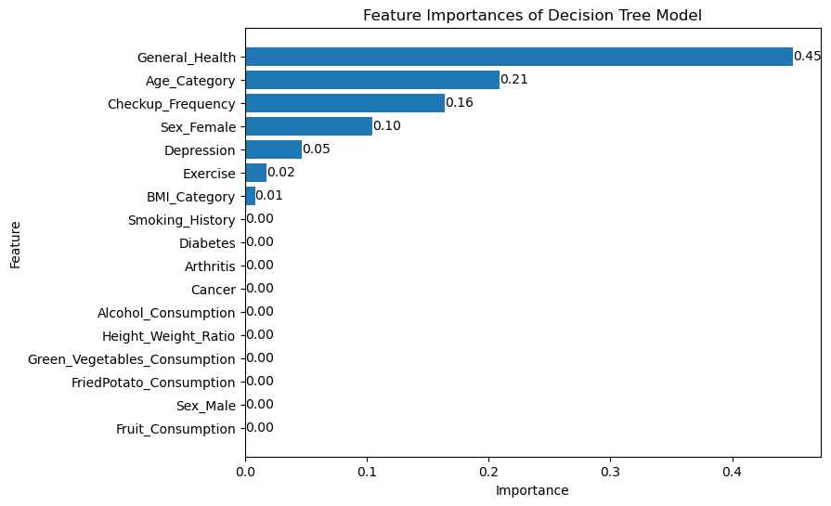
XG Boost Classifier
Accuracy | Precision | Recall
0.69 | 0.18 | 0.81

Slide 29
6
CONCLUSION
Key Insights and Next Steps

Slide 30
CONCLUSION
Objective : Categorize patients by utilizing machine learning concepts
Model Performance : Our logistic model achieved a recall score of 0.81, ensuring we can better identify potential risky patients.
Key Insights : The patient screening tool we propose must include "Age category", "general health", "smoking history", and "gender" since they emerged as important variables in predicting patient's susceptibility to CVD.
Implementations:
Health professionals: enhancement in patients screening, preventive treatment and resource allocation
Individuals: self-assessment / increase awareness and emergency handling
Notes:
health professional can use our project/model to enhance their patient screening process, improve resource allocation to people likely to have heart disease, and individual can use our project to conduct self assessment and increase awareness to this health issue

Slide 31
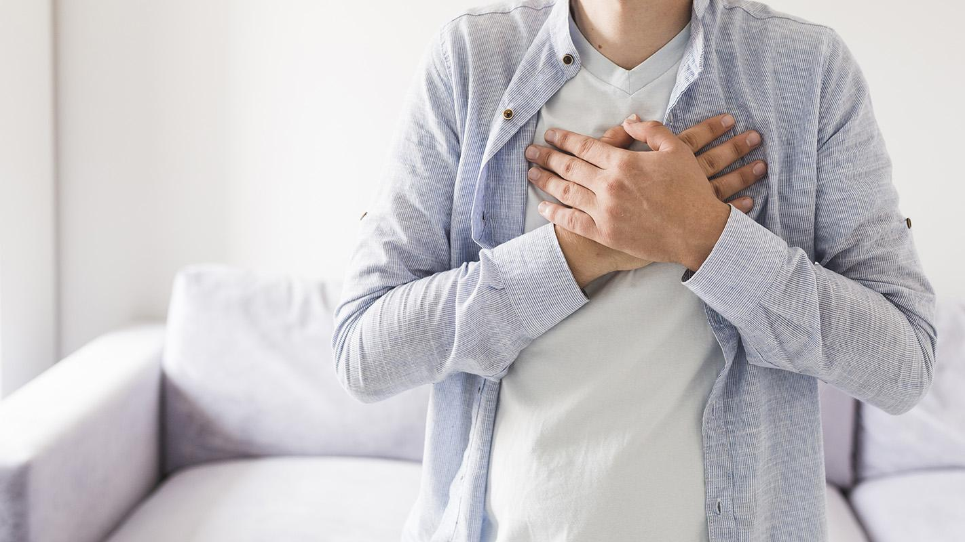
What Starts Here Changes the World

Slide 32
REFERENCES
Cardiovascular Diseases Risk Prediction Dataset. Kaggle, 2022 : https://www.kaggle.com/datasets/alphiree/cardiovascular-diseases-risk-prediction-dataset
Centers for Disease Control and Prevention. Heart Disease Facts. CDC : https://www.cdc.gov/heartdisease/facts.htm
https://www.healthleadersmedia.com/clinical-care/physician-appointment-wait-times-have-increased-significantly-survey-finds

Slide 33
Other Analysis......

Slide 34
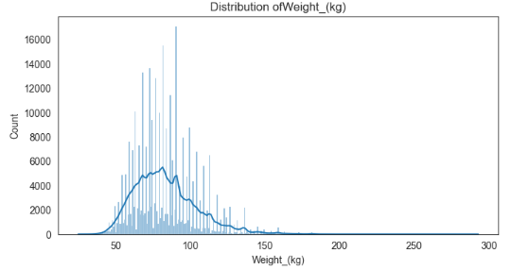
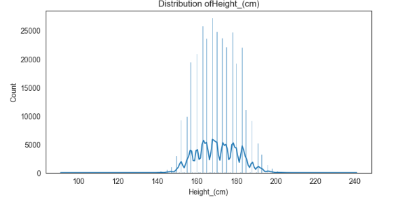
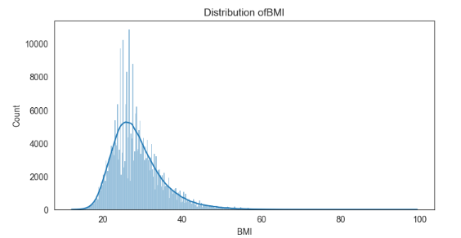
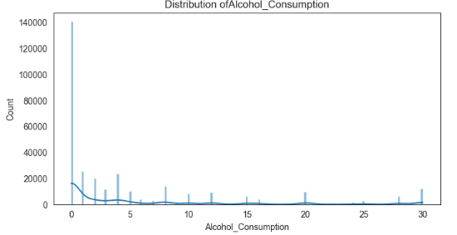
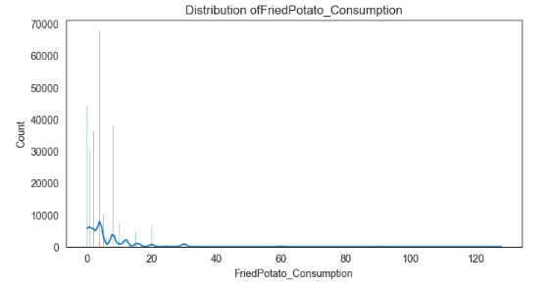
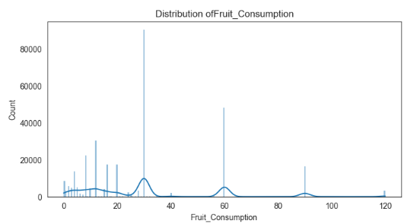
Univariate Analysis (Numerical features)
Notes:
patient data shows that
their height and weight follow a normal distributed
(BMI) 20-30, is right-skewed => considerable number of patients with BMI values exceeding 30, indicating obesity.
alcohol consumption per month, right-skewed => majority having low consumption
Similarly, the fruit consumption per month and green vegetables consumption per month are also right-skewed,=>many patients consume fruits and green vegetables moderately.
The consumption of fried potatoes per month is right-skewed => many patients consuming them infrequently, while a few consume them more often.

Slide 35
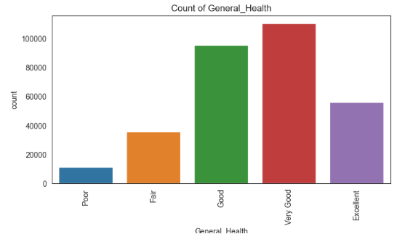
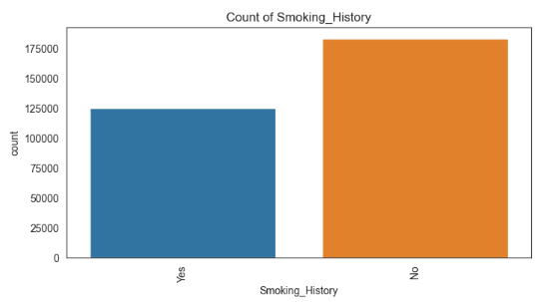
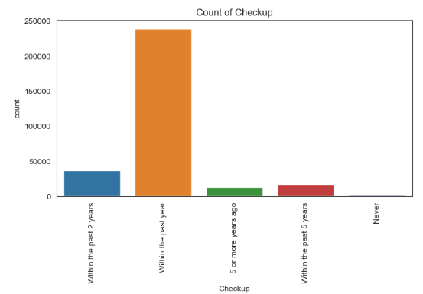
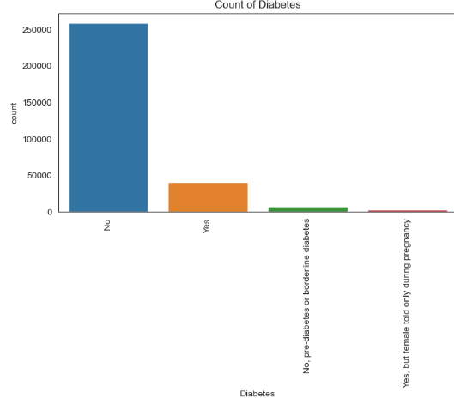
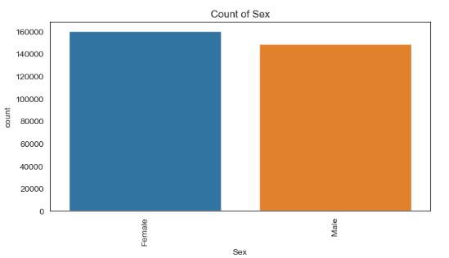
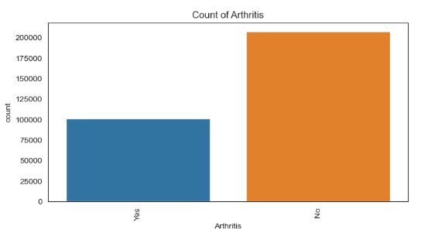
Univariate Analysis(Categorical Features-1)
Notes:
categorical variables displayed diverse distributions.
1.) most patients rated their general health as "Good" or "Very Good" and had their last checkup within the past year.
2.) and a majority did not have a history of smoking.

Slide 36
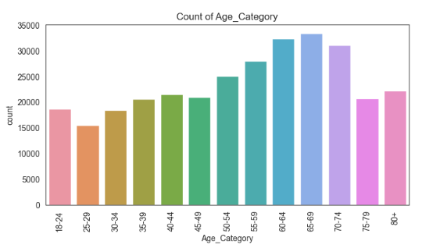
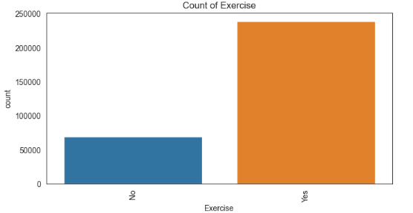
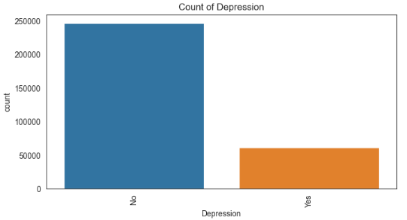
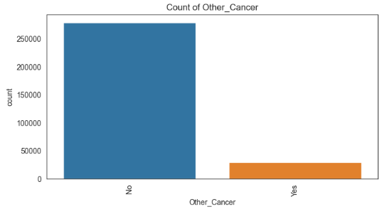
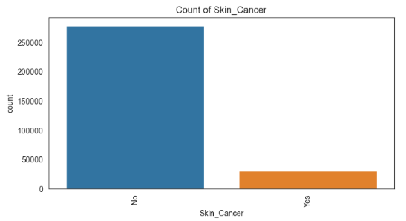
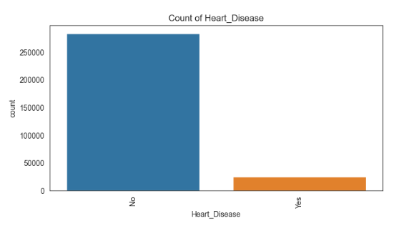
Univariate Analysis(Categorical Features-2)
Notes:
1.) most patients=> 50-64 age category
2.) most patients reported exercising regularly,
3.) Only a small proportion of patients have heart disease.

Slide 37
Major factors driving CVD!!!

Slide 38
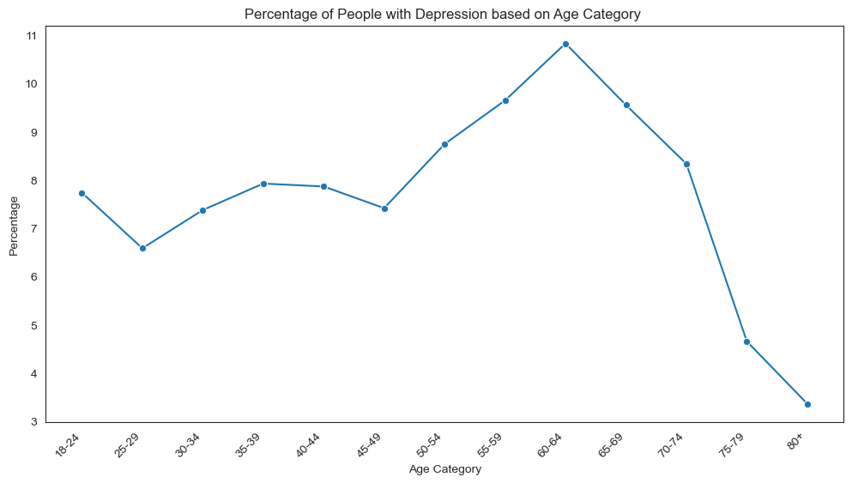
Does mid-life crises make you depressed?
Takeaway: Mid-life crises between 40-60 make people more depressed and lesser after retirement

Slide 39
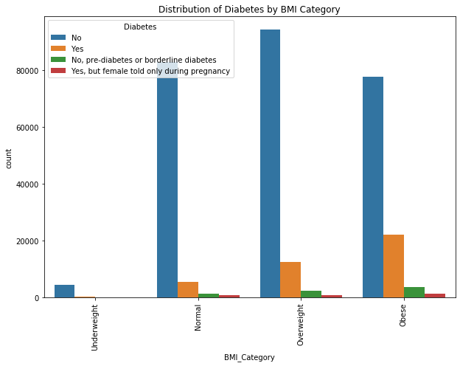
Are obese people more prone to Diabetes?
Takeaway:

Slide 40
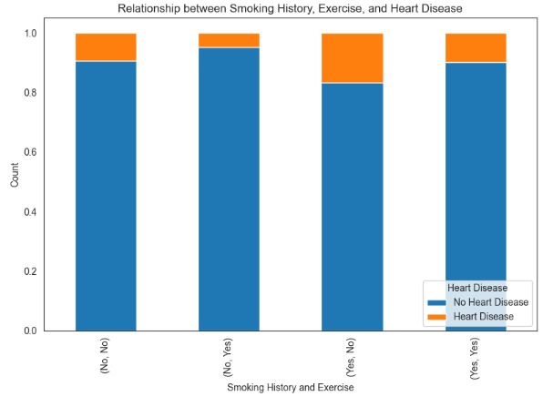
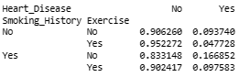
Relationship between smoking history, exercise and CVD
Takeaway: Not exercising and smoking is more detrimental for one's health

Slide 41
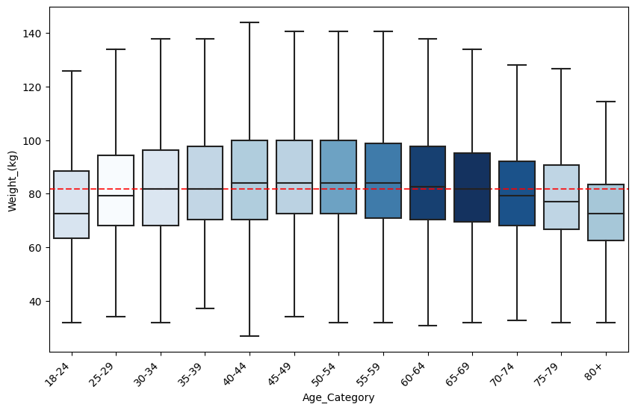
Is there a relation between age and weight? Do people gain weight over the years and lose it as they get older?
BMI vs CVD
Takeaway:

Slide 42
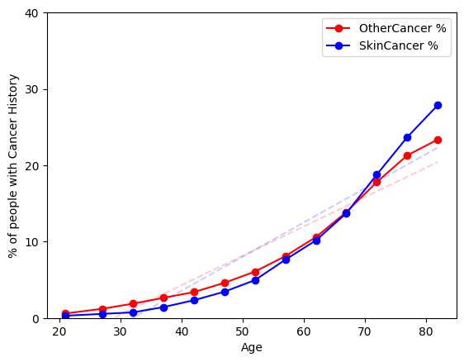
Are you prone to get cancer as you age? Is there a change in trend between skin cancer and other types of cancer?
Takeaway:
People have higher risk of cancer as they tend to get older
Younger people tend to have a slightly lower chance of getting skin cancer compared to other cancers whereas its opposite for older people

Slide 43
Slide Template

Slide 44
THANKS!
Do you have any questions?
youremail@freepik.com
+91 620 421 838
yourcompany.com
Please, keep this slide for attribution.

